Slide 1
Predicting DEM label-free

Slide 2
Part1
Problem and approach

Slide 3
Same physics, different training signal
Solvers (BP, ElasticNet) run one optimisation per pixel: accurate, but slow at full resolution.
Supervised
learns the solver's DEMs
Observed AIA
6 channels
Model
DEM
18 bins
Solver's DEM
label
loss
Label-free (unsupervised)
learns the solver's objective implicitly
Observed AIA
6 channels
Model
DEM
18 bins
Predicted AIA
via response R
Observed AIA
6 channels
loss
We never train on the solver's DEMs; we use them only to evaluate.
Notes:
The audience knows the inverse problem. This slide only says what is different about our training signal. BP and ElasticNet solve one optimisation per pixel. A supervised network learns to reproduce the solver's DEMs, so it needs them as labels. Ours learns to minimise the solver's objective directly, so it never sees a solver DEM; we use those only to evaluate.

Slide 4
The model: a small MLP feeding a fixed forward model
Observed AIA
6 channels
MLP
176k params
Basis weights
54, same as solver
DEM
18 bins, logT 5.5–7.2
Predicted AIA
via response R
Loss: the solver's objective, predicted against observed AIA
6 log-intensities in; 4 hidden layers of 232, SiLU; 54 non-negative basis weights out.
BP and ElasticNet solve for the same 54 weights (at each of 18 bins, a spike and Gaussians 0.1 and 0.2 dex wide), and their L1 term acts on those weights.
DEM = B·w over 18 bins; predicted AIA = R·DEM. B and R are fixed; only the MLP is learned.
176k parameters; one forward pass per pixel.
Notes:
The solvers never solve for the 18 bins directly: both solve for weights on a fixed basis, a spike and two Gaussians at each bin, and report DEM = B times x. We predict the same weights, so the network searches the same space of DEMs the solver does, and BP's sparsity criterion means the same thing for both. Only the MLP is learned. Per pixel: six log-intensities in, four hidden layers of 232 with SiLU, 54 non-negative basis weights out; DEM = B times w over 18 bins, logT 5.5 to 7.2; predicted AIA = R times DEM. 176k parameters, one forward pass per pixel.

Slide 5
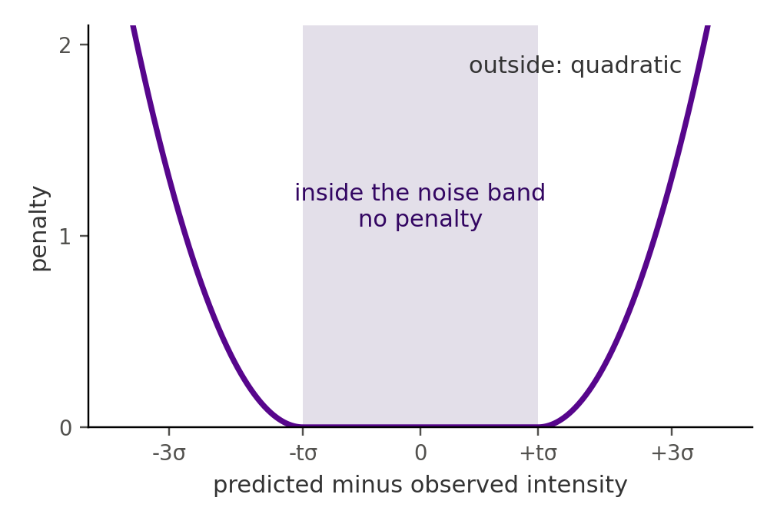
The loss is the solver's own objective
BP track
L = Σ_{c} [ max(0, |ŷ_{c} − o_{c}| − tσ_{c}) / tσ_{c} ]² + Σ_{k} w_{k}
Zero inside the noise band (t = 1.4), quadratic outside.
Then the L1 term picks the sparsest DEM that fits: BP's criterion.
ElasticNet track
L = (1/2C) Σ_{c} [ (ŷ_{c} − o_{c}) / tσ_{c} ]² + αλ Σ_{k} w_{k} + ½α(1−λ) Σ_{k} w_{k}²
The solver's settings: α = 0.001, λ = 0.5, C = 6.
The BP band penalty for one channel.
In both: ŷ = R·B·w, with w ≥ 0.
Notes:
BP track: the penalty is zero anywhere inside the noise band, o plus or minus 1.4 sigma, and quadratic outside, scaled by the band width. There is no fit term inside the band, so any DEM within noise is equally good, and the L1 term on the basis weights then picks the sparsest one: BP's own criterion. ElasticNet track: the solver's ElasticNet objective with its settings, alpha 0.001, l1 ratio 0.5, C equal to the six channels, using the same noise scaling. In both, y-hat is R times B times w, and w is non-negative.

Slide 6
Three routes to a DEM, compared on the same test
Solver (BP, ElasticNet): optimises its objective for each pixel. This is the reference.
Supervised network: learns to predict the solver's DEMs, so it needs them as labels.
Label-free network: learns to minimise the solver's objective, with no labels.
Same test for all: 153 days never seen in training, identical pixels. DEM metrics against the solver; AIA reconstruction against the observation.
Notes:
Data: 1,223 Hofmeister-deconvolved timestamps, split by day into 917 train, 153 validation and 153 test. The networks never see a test day in training. DEM metrics compare each network with the solver's DEM: MSE, total-emission error and W1. AIA reconstruction compares all three with the observation: MAE and MSE.

Slide 7
Part 2
Problem and approach

Slide 8
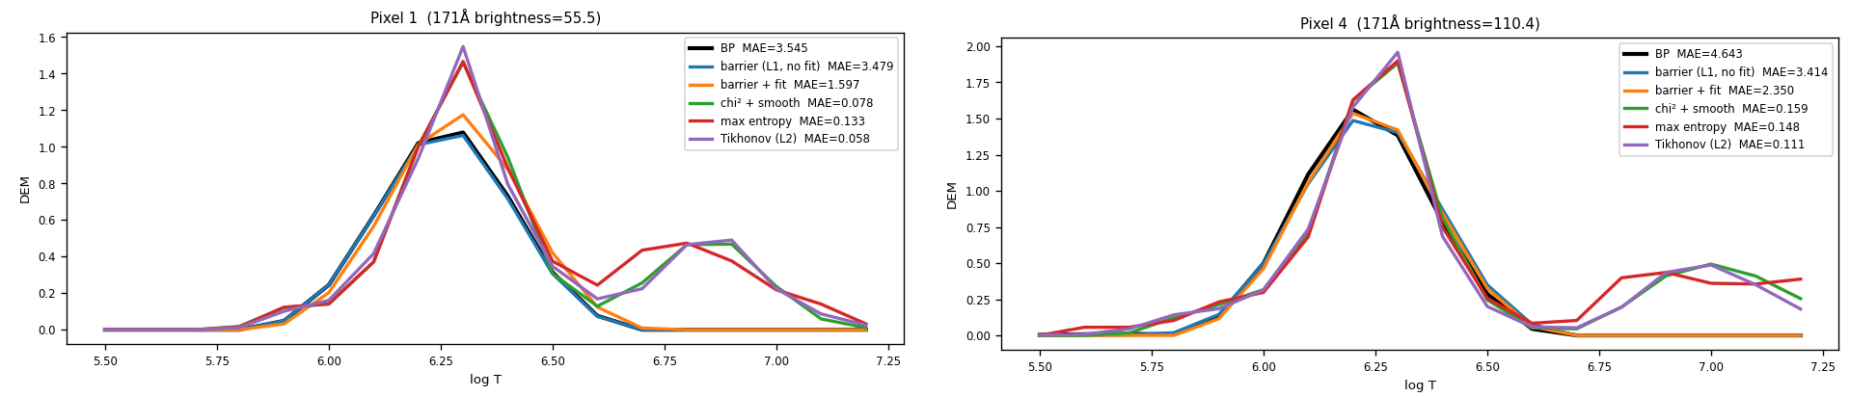
Six channels underdetermine the DEM: the regulariser picks it
Before any network: five losses optimised directly, pixel by pixel, on 4 timestamps, each compared with BP.
Fit-only losses (χ² + smoothness, max entropy, Tikhonov) reconstruct AIA ~12x better than BP, yet land ~5x further from its DEM.
BP's own terms (noise band + L1) land on BP's DEM: MAE 0.03 vs 0.18–0.20.
Two example pixels; BP in black. Legend MAE is AIA reconstruction error.
So the network has to train on the solver's objective, not on fit.
Notes:
Before any network, five losses optimised directly per pixel on 4 timestamps. Averages: AIA MAE against the observation, BP 5.2, barrier 5.0, barrier plus fit 2.6, fit-only 0.40 to 0.44. DEM MAE against BP: barrier 0.034, barrier plus fit 0.043, fit-only 0.18 to 0.20. W1 on the brightest 5% of pixels: 0.030 and 0.033 against 0.15 to 0.18. Six equations, eighteen unknowns: many DEMs fit within noise, so whatever breaks the tie decides the shape. L-BFGS and Adam reach the same curves; SGD often fails to converge.

